Slide 1
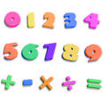
Primary 1 2019
Numeracy Curricular Evening
Notes:
Welcome, fire exit, questions!

Slide 2
Learning Numbers
Our number system, to children takes time to truly understand – in the same way a foreign language takes time for adults to learn. Take a mental note …
0 1 2 3 4 5
⌂ ₣ ∂ ς φ Ω
Notes:
Will have been exposed to numbers but need a true, deep understanding. Being able to count to 10 proves a good memory, not always a true understanding of what the numbers actually mean. Flashcards with symbols – can parents call out the numbers/put in order/write them etc.

Slide 3
Numeracy/Maths
Numeracy is all aspects of number -
addition and subtraction
Maths is all other areas including
time/data handling/shape and measure
This includes numbers but is called Maths

Slide 4
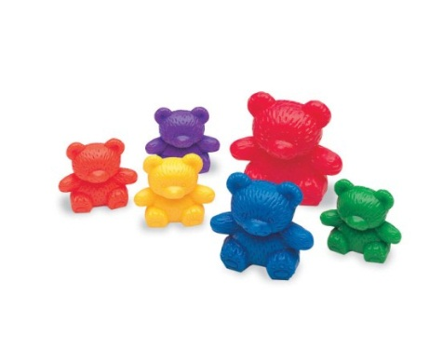
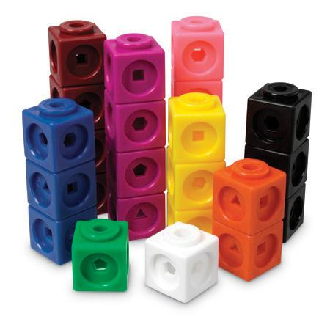
Numbers to 10
Emergent counting (1 to 1 counting) – with visible items.
Perceptual counting – seeing, hearing or feeling items.
Figurative Counting – count concealed items
Notes:
Children can use their fingers! Number formation also important. Demo each stage 1. handful of teddies, card peg on. 2.difference towers. 3. Bucket count on.

Slide 5
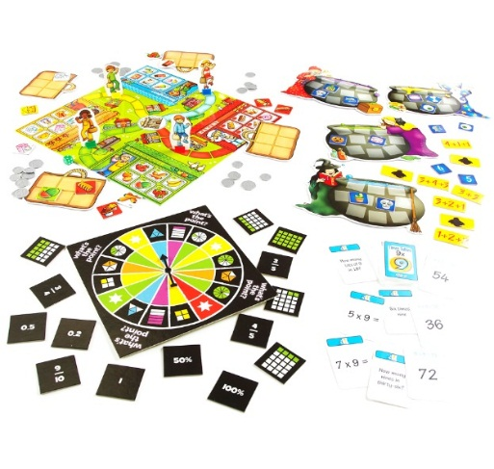
Maths Games
Developing and consolidating their understanding
Fairness and cooperation
Explaining to others/peer support using mathematical language
Challenge
Linking learning
Notes:
Show a few games that we play as a class (mystery number, counting pendulum & stick, ten frames, board games out to see at end, smartboard game to demo.

Slide 6
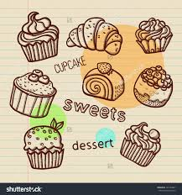
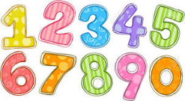
Number Talk
Mrs. Wilson had 8 cakes
She gave Mrs. Russell 4 cakes
How many did Mrs. Wilson
have left?
Tell me how you worked it out?

Slide 7
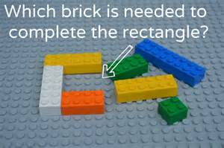
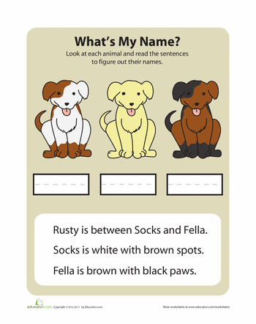
Problem Solving
Taking in all areas of Maths
Different learning styles – practical, visual
Able to use a variety of maths skills
Notes:
Share some problem solving activities -

Slide 8
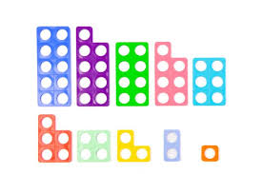
Numicon
This will be used to develop different number skills including number bonds.
It is very visual and engages the child in learning

Slide 9
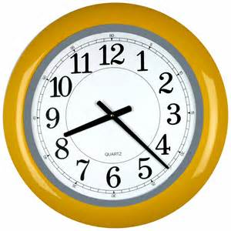
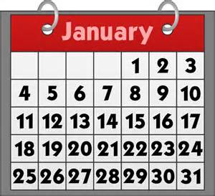
Everyday Numeracy
Numeracy is all around us….
Shopping lists calendar
page numbers price tags clock
Reference number phone numbers
Bus timetable house numbers
Packaging money
Notes:
Encourage your child’s curiosity. Let them see how you use maths skills everyday. Discuss other areas of maths we teach – pattern, beebots etc

Slide 10
And now………
it’s over to YOU!!

Slide 11
Easy as 1, 2, 3…
Can you remember these numbers?
ς ₣ Ω ∂ ⌂ φ
Notes:
Order: 3, 1, 5, 2, 0, 4. Maths should be fun & challenging but achievable. Everyone gets there in their own time!

